Slide 1





Superstore Sales Prediction

Slide 2

Project Overview
  What is the goal?
    To build a robust predictive system that estimates Sales using historical order data from the Superstore dataset.
  Why?
    Sales forecasting helps companies decide:
    Inventory planning
    Pricing strategies
    Regional performance
    Customer segmentation

Slide 3
Project Pipeline
Exploratory Data Analysis
Categorical Encoding
Scaling
Model Comparison
1
2
3
4
5
6
7
8
9
Data Loading & Cleaning
Feature Engineering
Outlier Handling
Model Training
Deployment with Streamlit

Slide 4
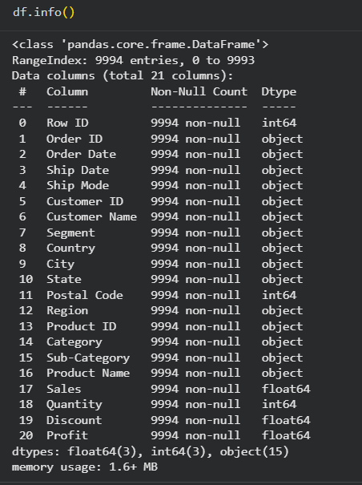

Our Core Strengths
The dataset contains:
  9,994 rows
  21 features (after dropping unnecessary columns → 16 remain)
  Includes customer info, shipping info, product categories, pricing, profit, and dates.
Types of data:
  Categorical: Ship Mode, Segment, Region, Category, City, etc.
  Numerical: Sales, Quantity, Discount, Profit
  Date: Order Date, Ship Date

Slide 5




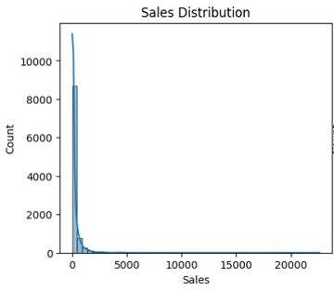
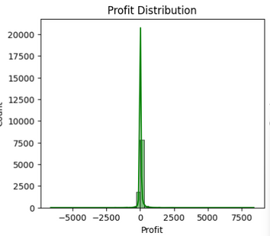
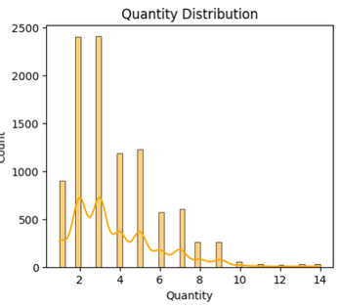
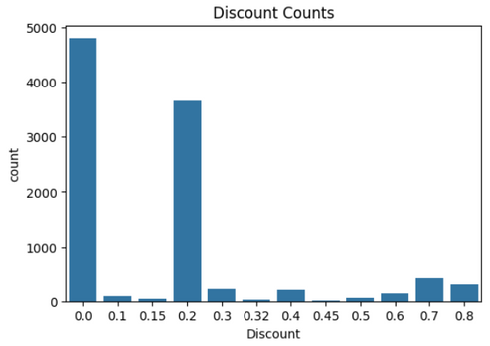
Exploratory Data Analysis
Important insights:
Sales distribution is right-skewed (few very high sales)
Profit has outliers (both high profit & high loss)
Discount has repeated values (0.0, 0.2, 0.8)
Quantity is mostly below 10

Slide 6
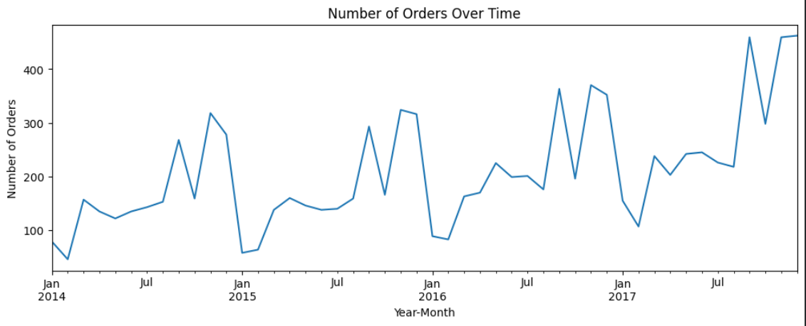
Feature Engineering
Extracted Features
  OrderYear
  OrderMonth
  ShippingDelay = Ship Date – Order Date
  Dropped non-essential columns: Row ID, Order ID, Customer ID, Product ID…
Why these features matter
  Year & Month capture seasonality
  Shipping delay correlates with operational cost & satisfaction
  Removing irrelevant columns prevents noise

Slide 7

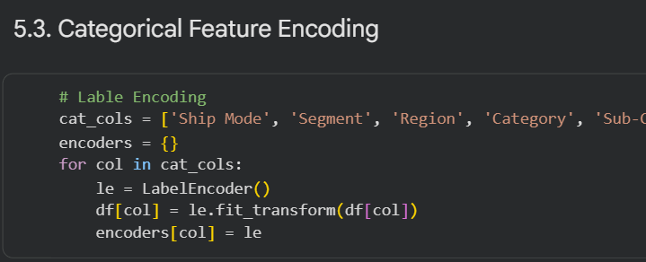

Encoded the following columns using LabelEncoder:
(Ship Mode, Segment, Region, Category , Sub-Category, Product Name, City, State)
Categorical Encoding
Why Label Encoding?
  Tree-based models prefer integer categorical labels
  Ensures consistent representation
  Saves encoder dictionary for deployment

Slide 8
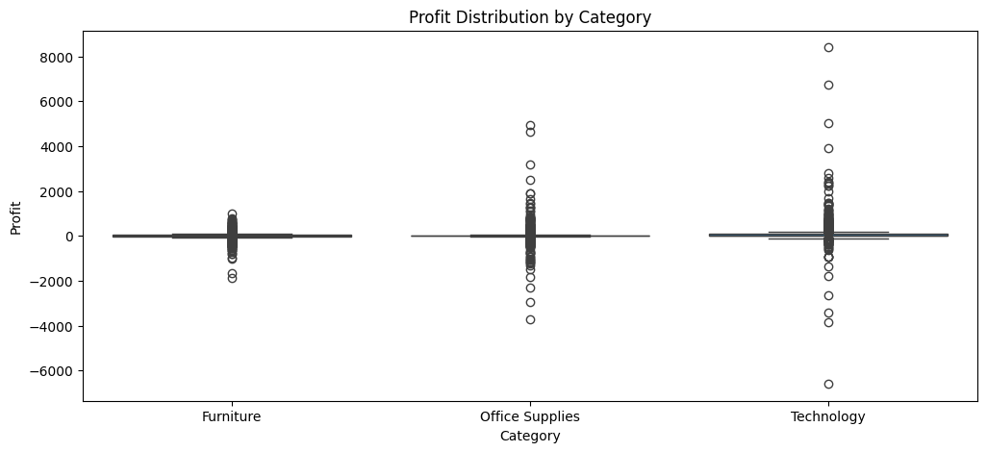
Outlier Handling
Using Quantile Clipping (1% to 99%)
  Profit → Profit_clipped
  Sales → Sales_clipped
  Quantity → Quantity_clipped
Why Clipping?
  Reduces effect of extreme outliers
  Improves model stability
  Avoids bias caused by rare values

Slide 9
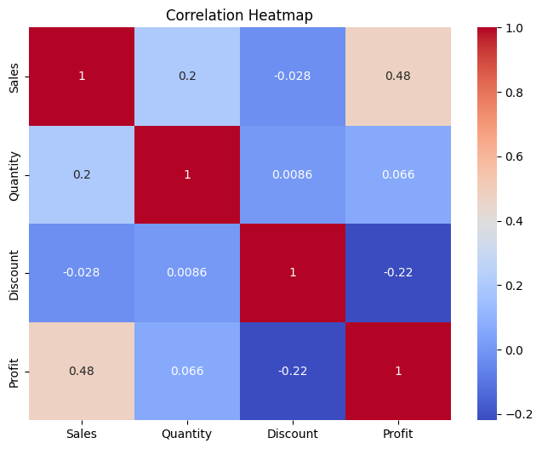
Data Splitting & Scaling
Split:
  80% training
  20% testing
Scaling:
  SVR uses StandardScaler
  Neural Network uses separate X and y scalers
  Tree models (RF & DT) do not require scaling

Slide 10
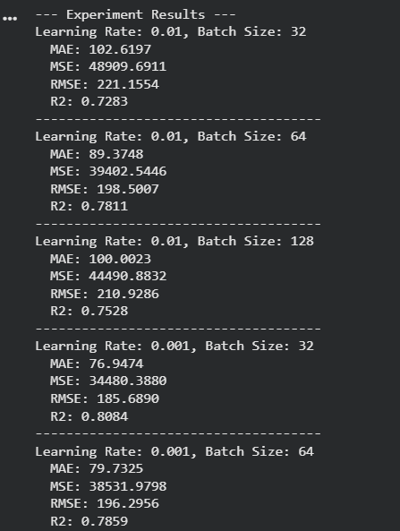
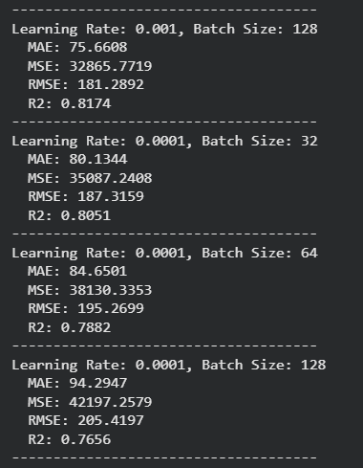
Hyperparameter Tuning - LR & Batch Size

Slide 11
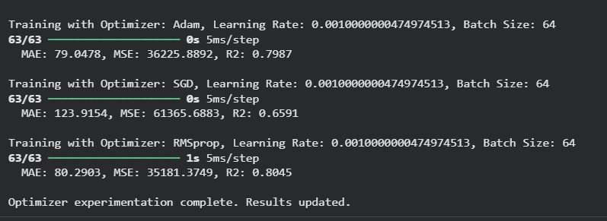
Hyperparameter Tuning - Optimizers

Slide 12
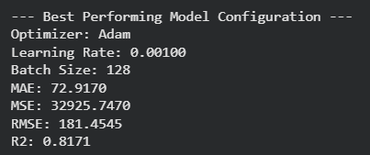
Best Performing Model Configuration

Slide 13
Machine Learning Models Used
1. Decision Tree
  Simple
  Interpretable
  Does not generalize well
  Medium performance
2. Random Forest
  Best performer
  Handles high-cardinality categorical features
  Robust to outliers
  Lower variance
3. SVR
  Good for smooth, nonlinear patterns
  Requires scaling
  Slower
4. Neural Network
  Complex nonlinear relationships
  Needs scaled inputs
  Performs well but sensitive to training parameters

Slide 14

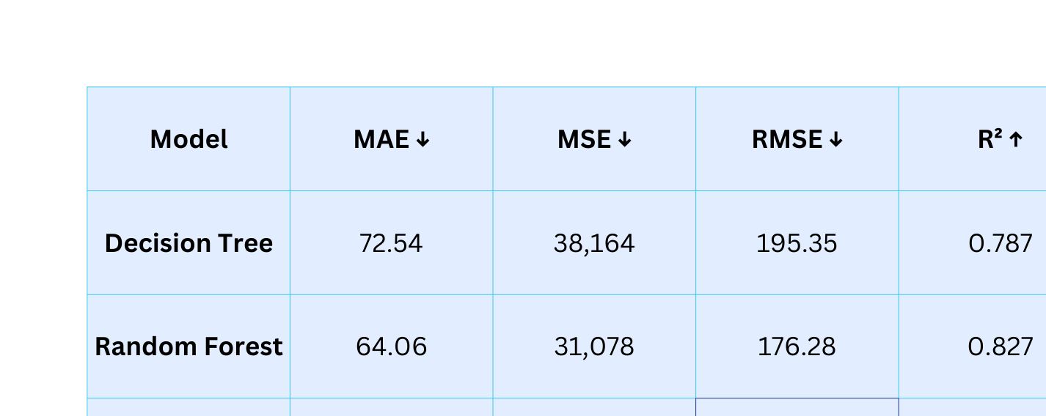

Model Evaluation Results
Conclusion: Random Forest is the strongest performer.

Slide 15


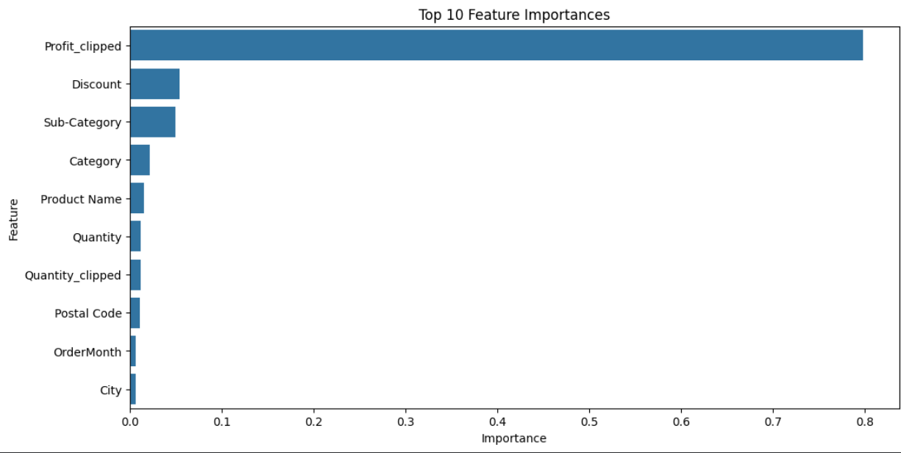
Random Forest feature importance

Slide 16
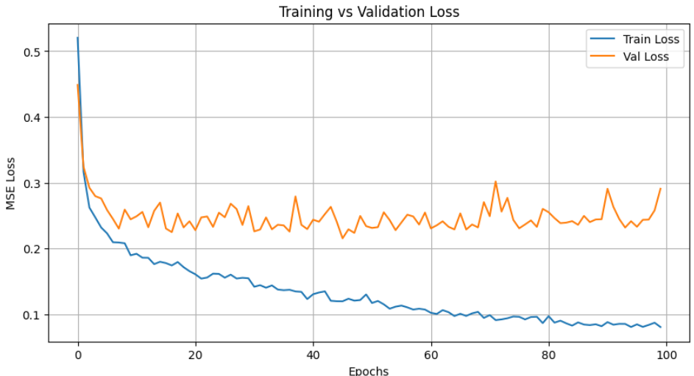
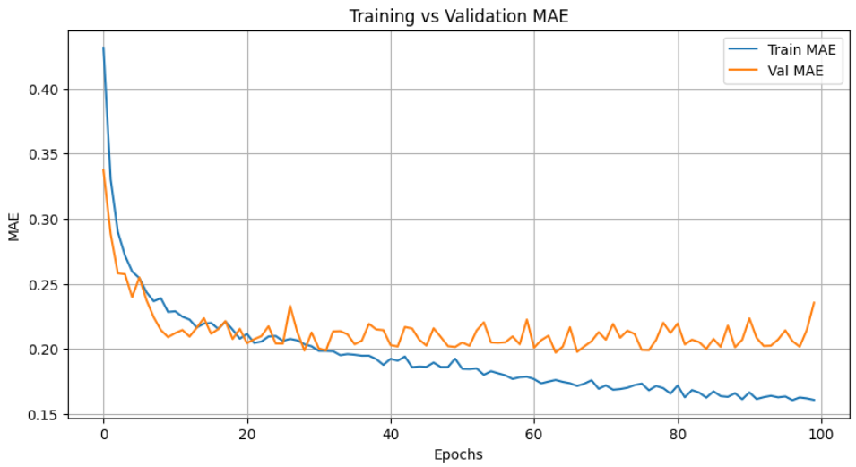
Neural Networks Results
MSE
MAE

Slide 17
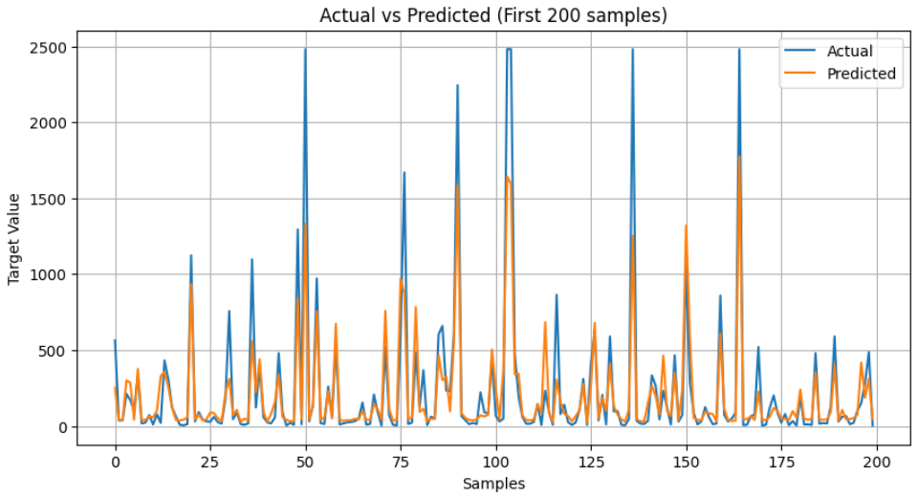
Predictions vs actual values

Slide 18

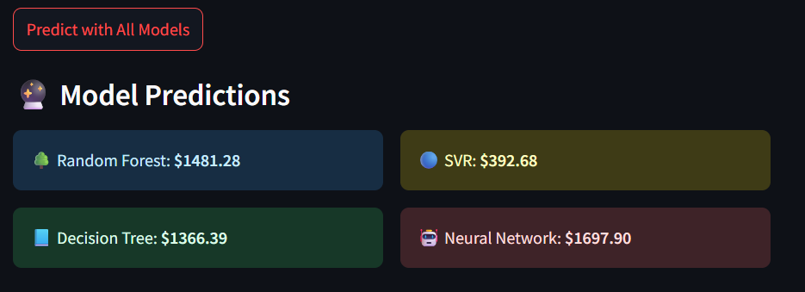
Deployment Architecture
How Deployment Works
  User enters order details
  Data passes through saved LabelEncoders
  Data is ordered using "feature_order.joblib"
  Model-specific preprocessing is applied
    RF & DT: raw features
    SVR: scaled with standard_scaler_sklearn
    NN: separate scalers for X and y
  Predictions generated from 4 models
  Streamlit displays results

Slide 19
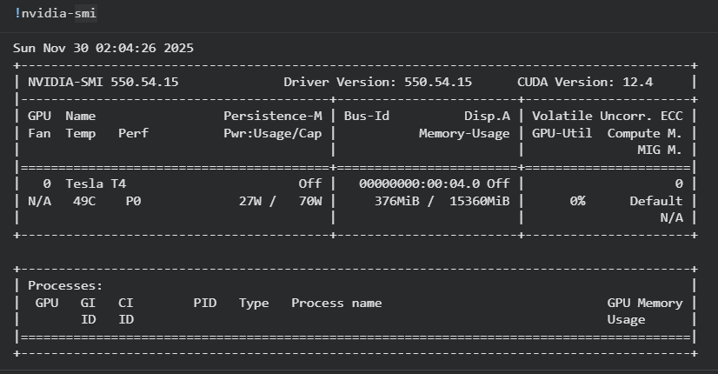
GPU Acceleration
Why Use GPU?
Speeds up neural network training
Handles large matrix operations more efficiently
Allows more epochs and deeper models
Reduces overall experiment time
How It Was Used
Google Colab GPU runtime enabled
Runtime → Change runtime type → GPU

Slide 20

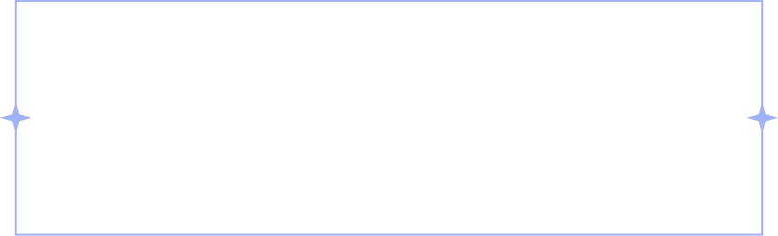
Conclusion
Key Achievements
  Complete ML pipeline for retail sales forecasting
  Strong EDA and feature engineering
  Comparison of 4 different ML methods
  Deployment-ready solution
  Random Forest identified as most accurate model
Future Improvements
  Hyperparameter tuning
  Try XGBoost or LightGBM
  Use embeddings for product names
  Deploy using Docker or cloud hosting

Slide 21


Thank You
Questions?

